Slide 1
Performance Specifications & Root Locus Review
Performance specifications
  Continuous-time (review)
Root Locus (review)
  Design example

Slide 2
Performance Specifications
Consider a continuous-time step response:
y(t )
y_{ss}
t

Slide 3
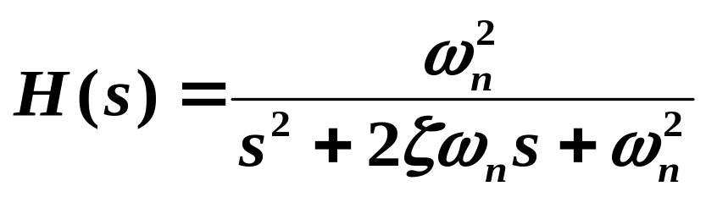

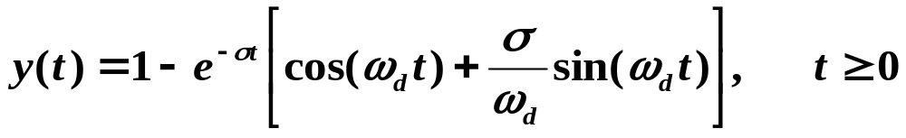
For a 2nd-order continuous-time system:
Step response:
Im(s)
Re(s)
See Figure 2.4 of text.

Slide 4
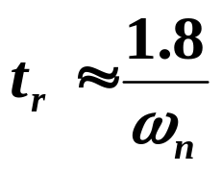
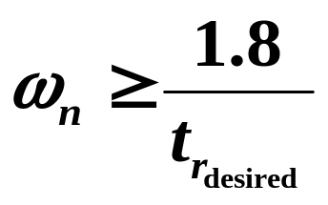
Rise time depends primarily on ω_{n} :
Im(s)
Re(s)

Slide 5
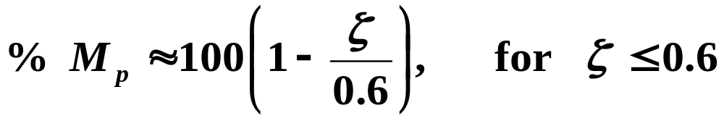
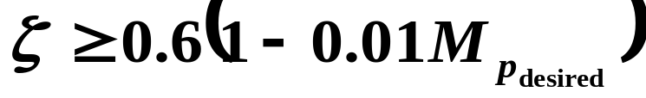
Percent overshoot depends only on ζ :
See Figure 2.7 of text.
Im(s)
Re(s)

Slide 6

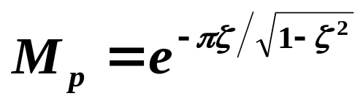
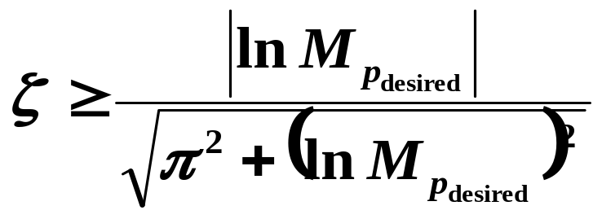
Can derive a more precise formula for M_{p} by determining and setting it to 0 to find the time t_{p} when M_{p} occurs.
Im(s)
Re(s)

Slide 7
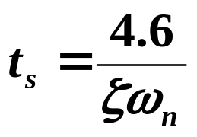
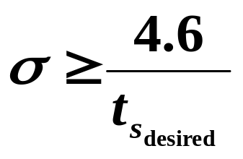
Settling time depends only on σ :
Im(s)
Re(s)

Slide 8
Combining performance specifications on rise time, overshoot, and settling time:
Im(s)
Re(s)
If H(s) has additional zeros or poles:
  Additional zeros increase overshoot
  Additional poles increase rise time
This is similar to H(z) having additional zeros or poles:
  Additional zeros increase overshoot
  Additional poles increase rise time

Slide 9






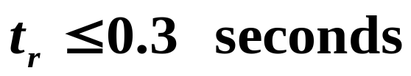
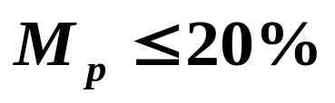
Discrete Equivalent Design Example
Σ
Performance specifications:
First design D(s) to meet specifications.
Then map over to a D(z), with T = 0.075 seconds.

Slide 10
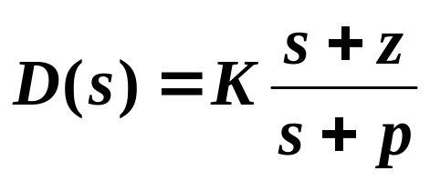
Design a lead network to meet specifications:
Want to design D(s) such that closed-loop poles are in desired region:
Im(s)
Re(s)

Slide 11
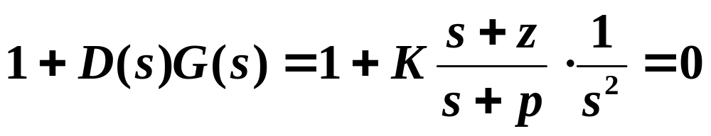
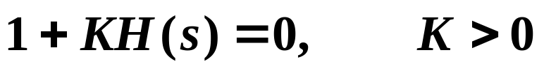
Root Locus Review
After choosing z and p, can just plot locus of roots
of closed-loop equation as a function of K using root
locus method:
180º Root Locus
Im(s)
Mark poles and zeros of H(s) in complex s-plane.
Segments to the left of an odd number of poles and zeros on the real axis are on the locus.
Re(s)

Slide 12
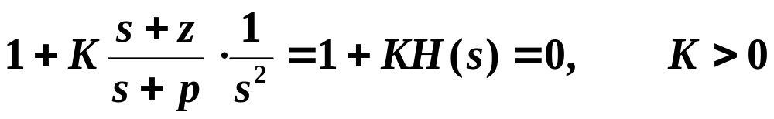

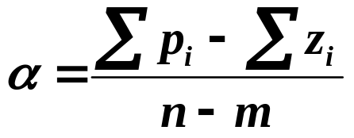
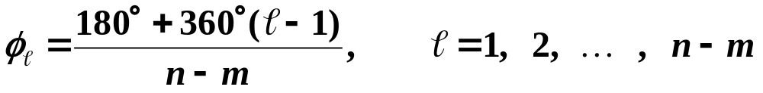
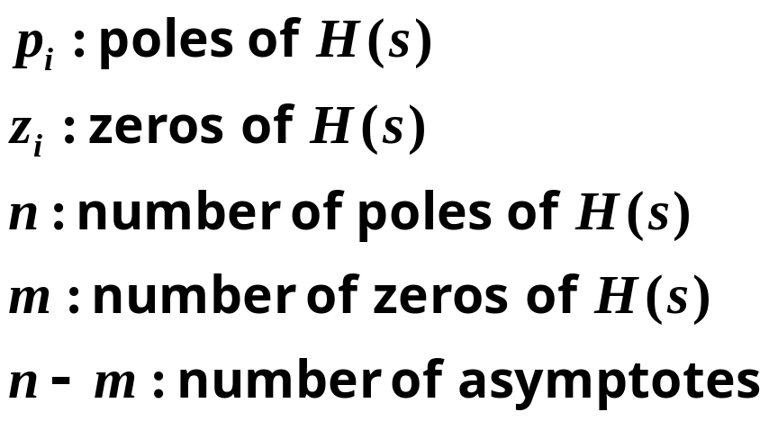
Sketch (n – m) asymptotes for
Im(s)
Re(s)

Slide 13
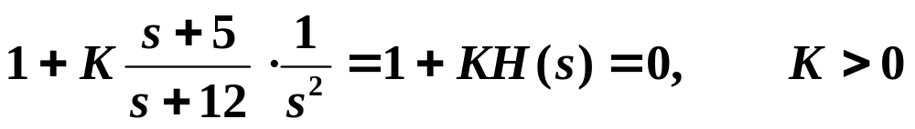
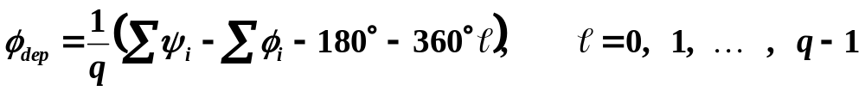
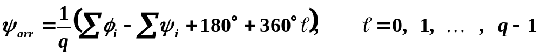
Determine departure angles from poles and arrival angles to zeros:
Im(s)
Re(s)

Slide 14
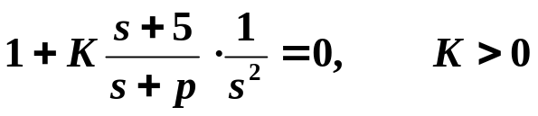
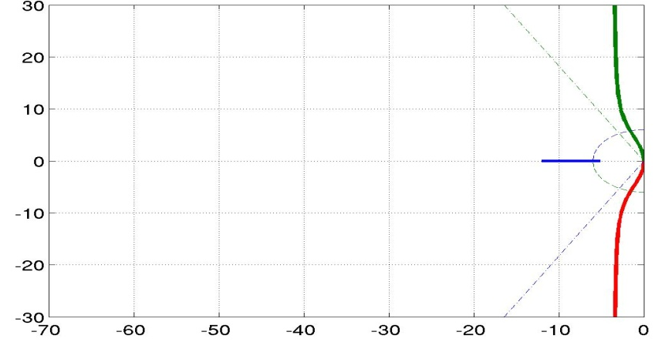
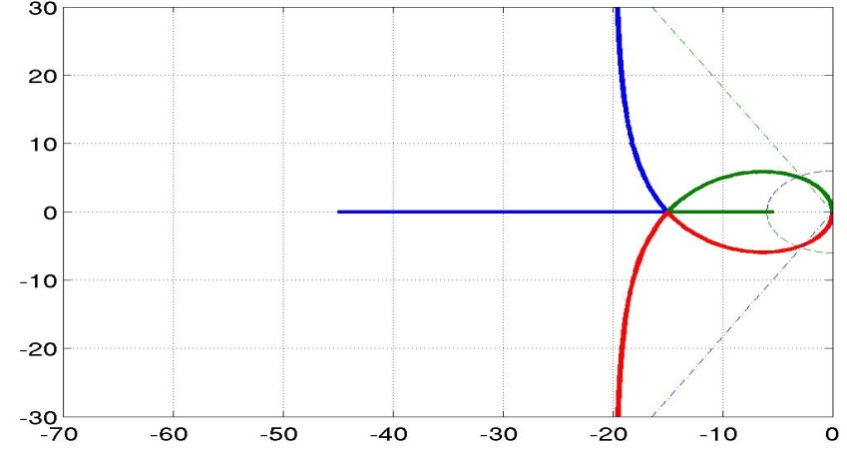


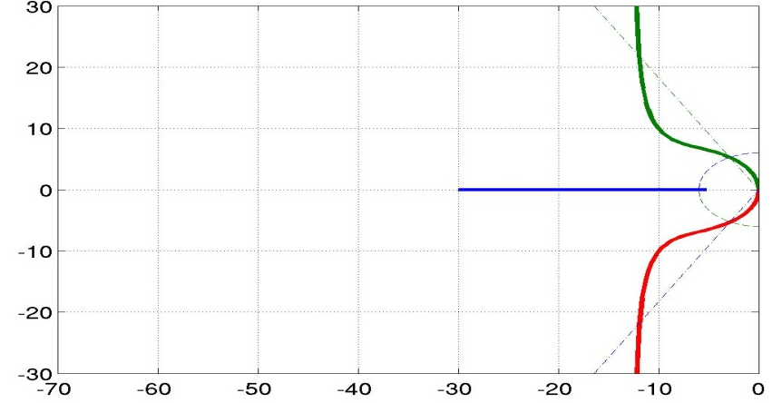
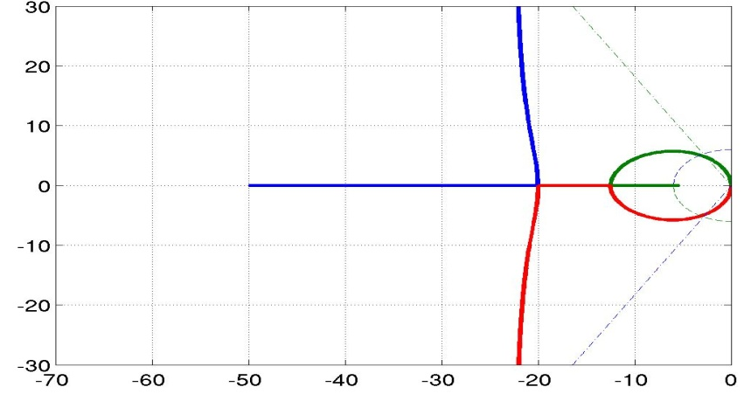


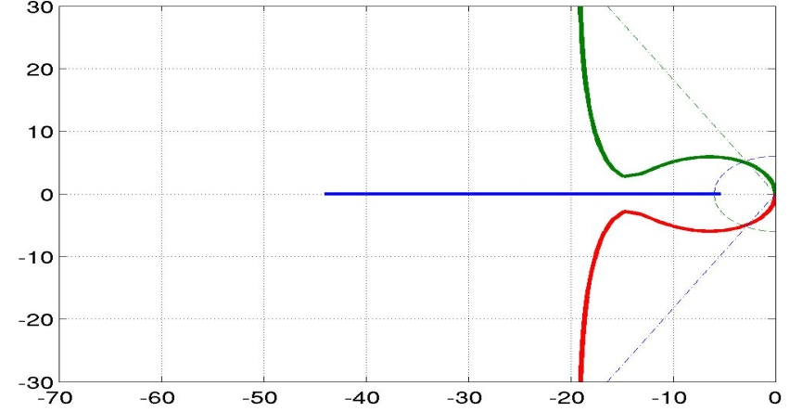
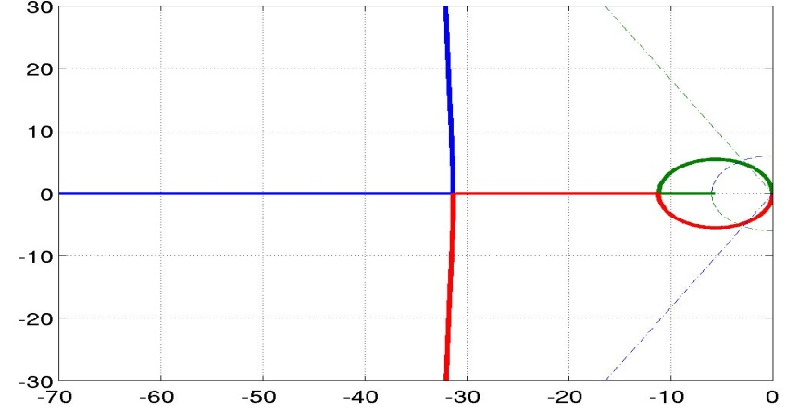


Im(s)
Im(s)
Im(s)
Im(s)
Im(s)
Im(s)
Re(s)
Re(s)

Slide 15
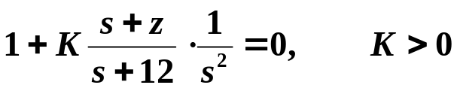
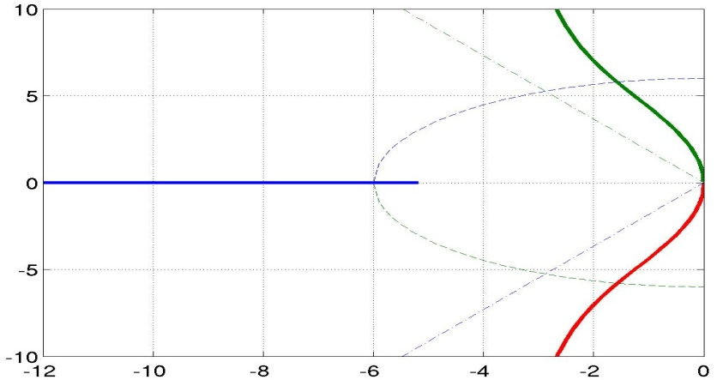
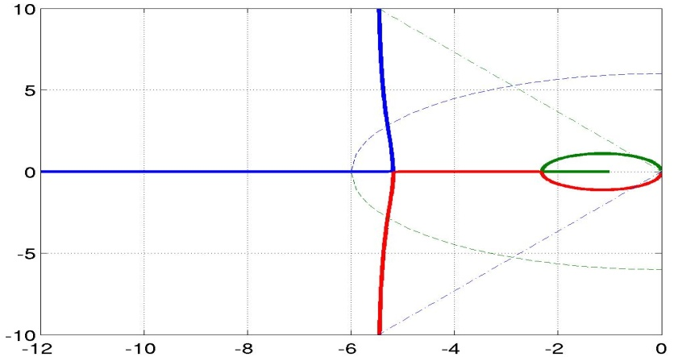


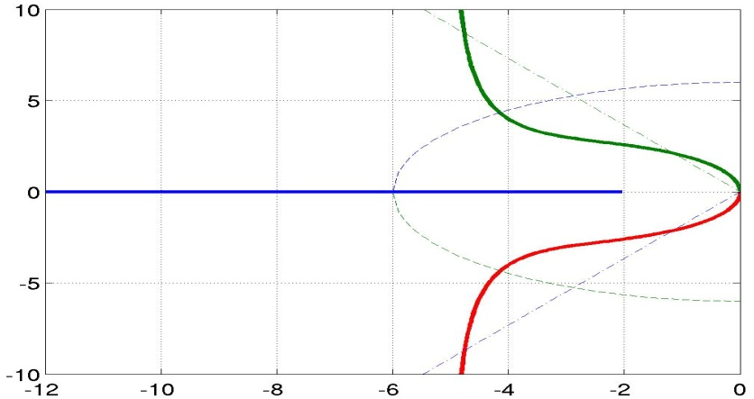
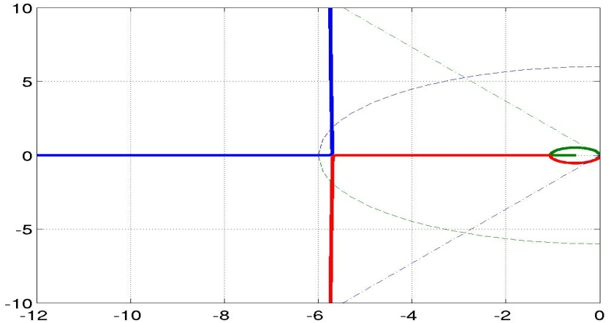


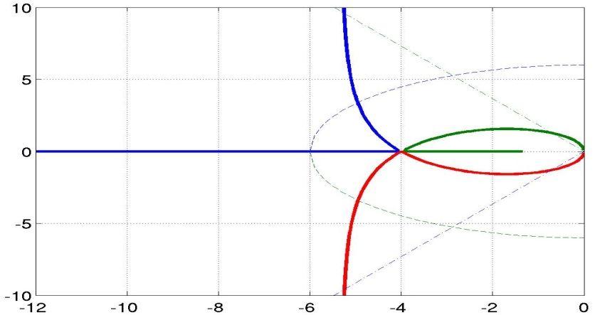

Im(s)
Im(s)
Im(s)
Im(s)
Im(s)
Im(s)
Re(s)
Re(s)

Slide 16
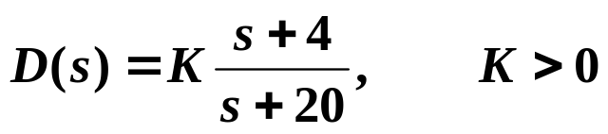
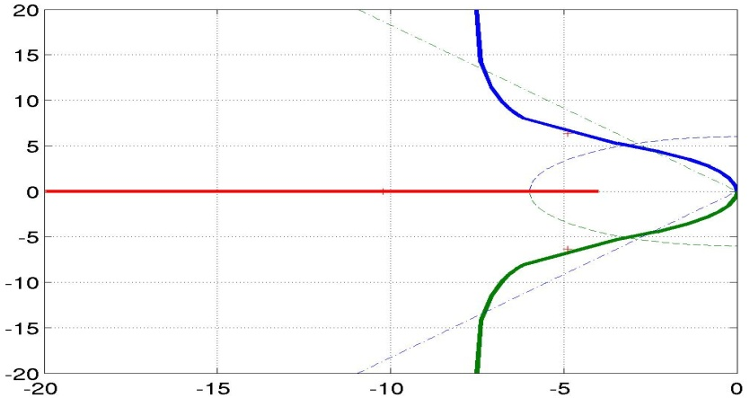

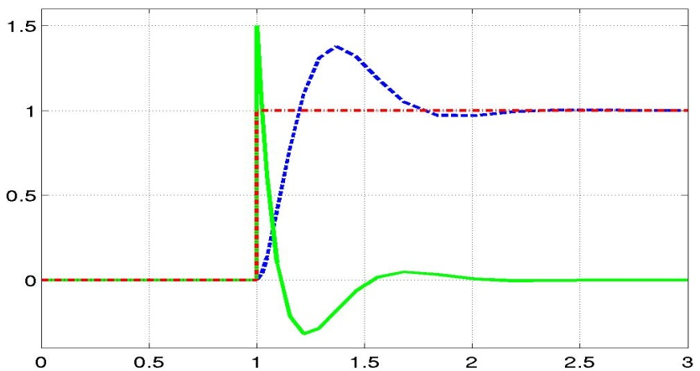
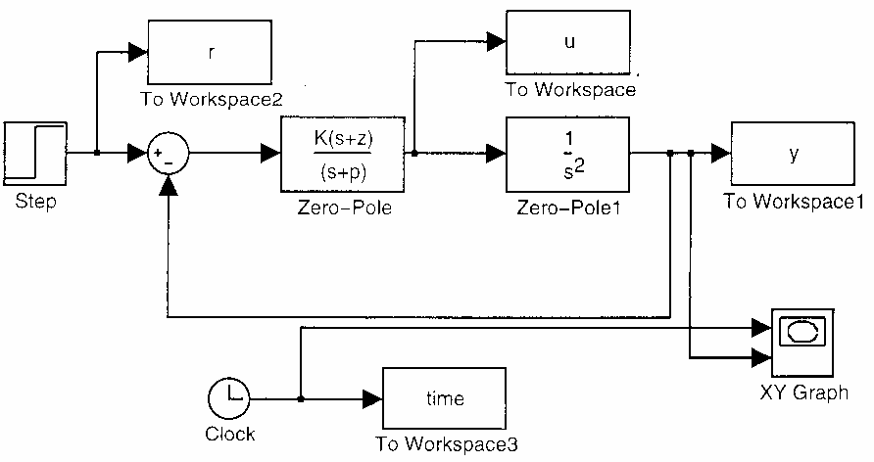



Choose
Input r
Control u/100
Output y
Im(s)
r, u/100, y
Re(s)
Time (seconds)
Useful MATLAB
commands:
rlocfind, sisotool

